Slide 1
The Adjustment of Hyperparameters and Model Architecture in Prediction Model of OVF Collapse Progression
렛서 연구원
김 시 빈

Slide 2
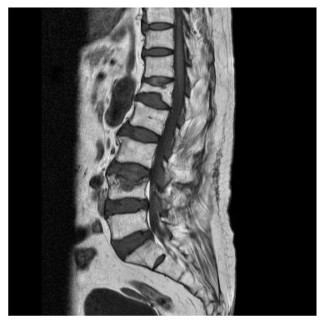
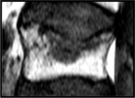
Osteoporotic Vertebral Compression Fracture
Vertebral Collapse
7-37%
Notes:
여기가 문제에요

Slide 3
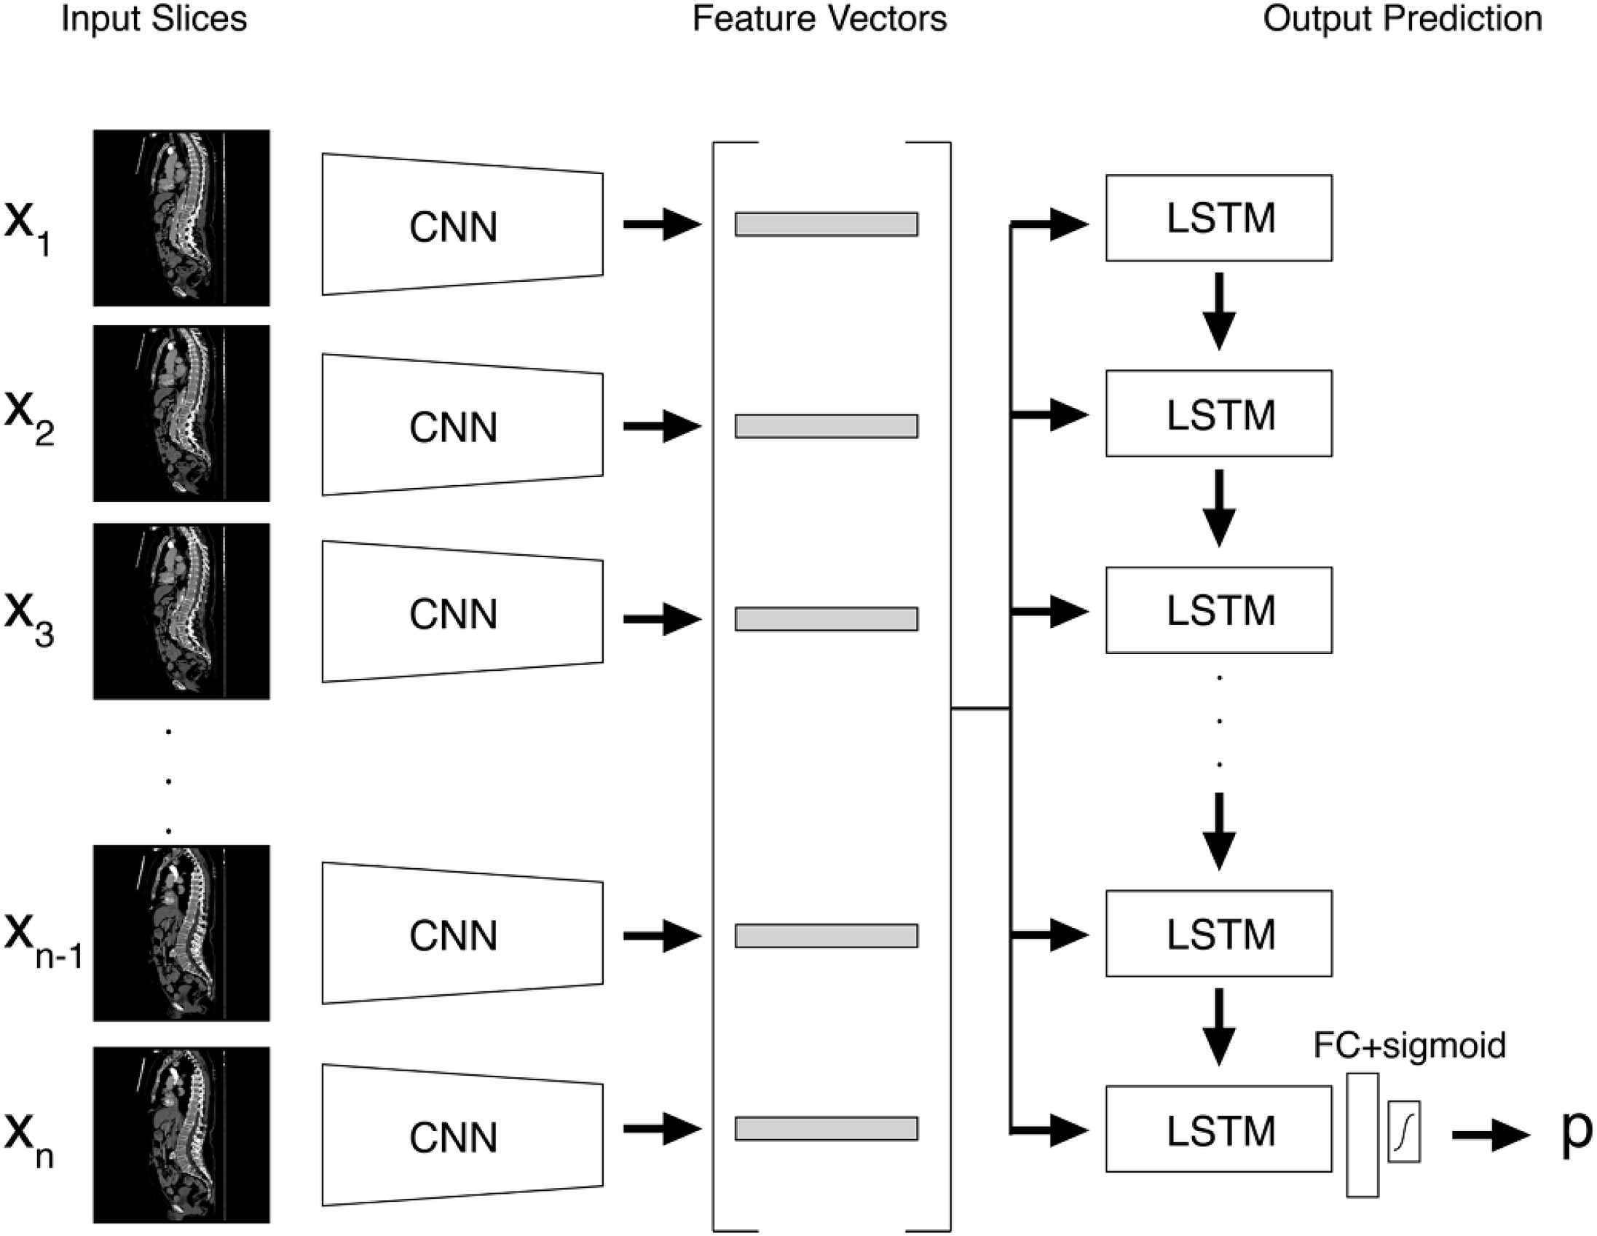
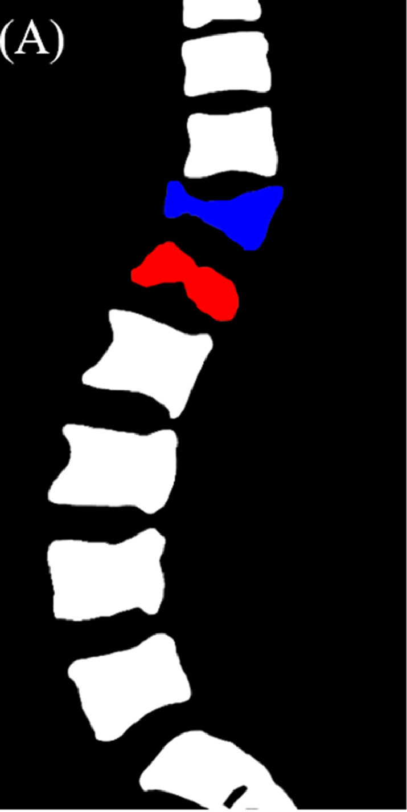
CNN for OVF Diagnosis
Old
vs.
Fresh

Slide 4
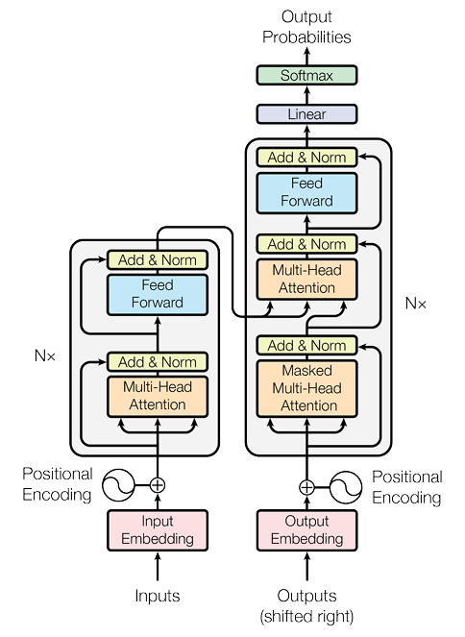
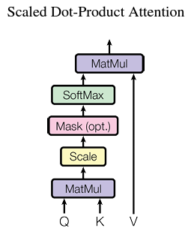
Transformer
BERT, ViT
GPT

Slide 5
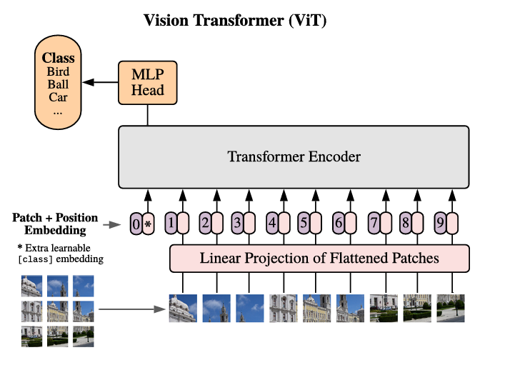
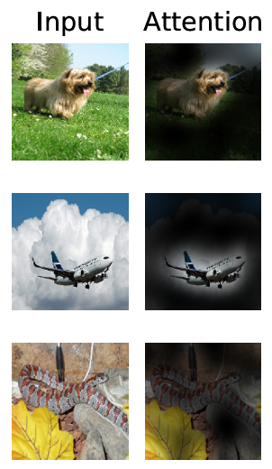
Vision Transformer
?

Slide 6
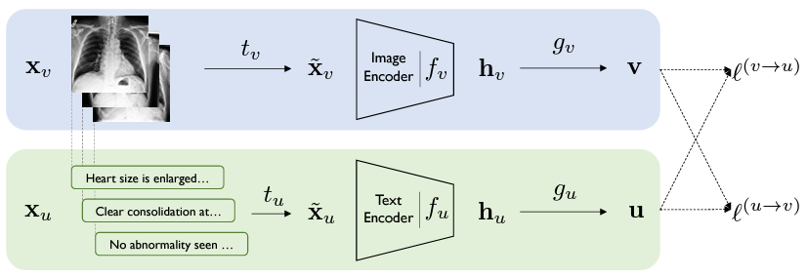
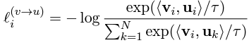
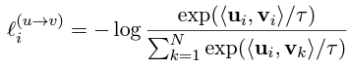
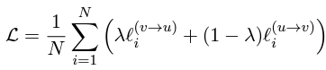
Contrastive Visual Representation Learning from Text

Slide 7
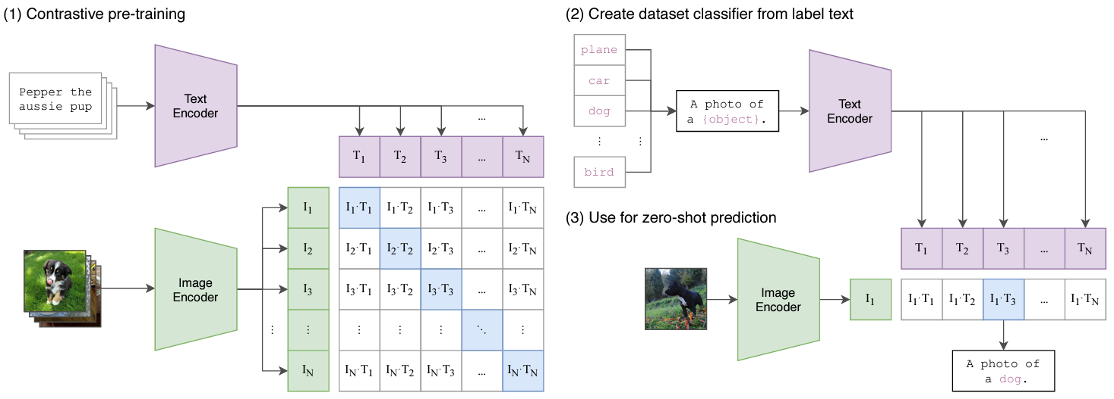
CLIP
e.g. ViT

Slide 8
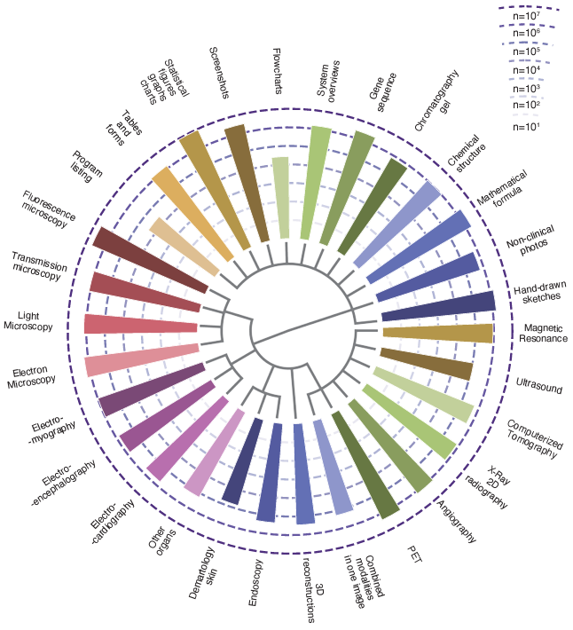
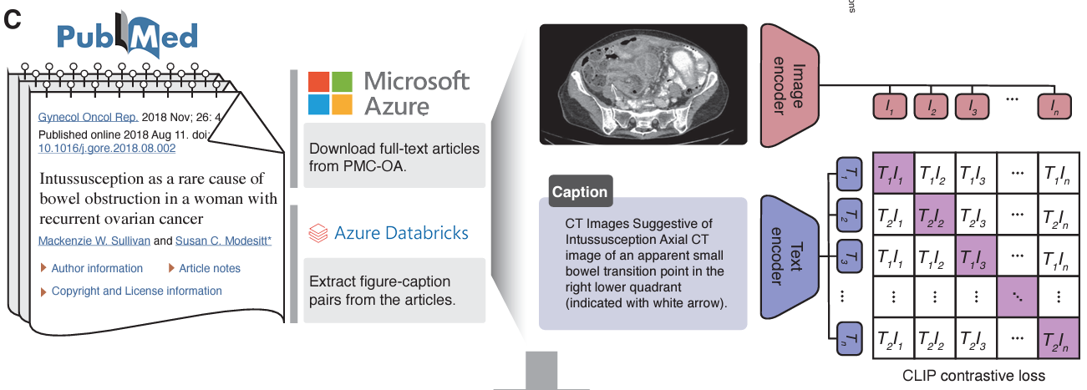
BiomedCLIP

Slide 9
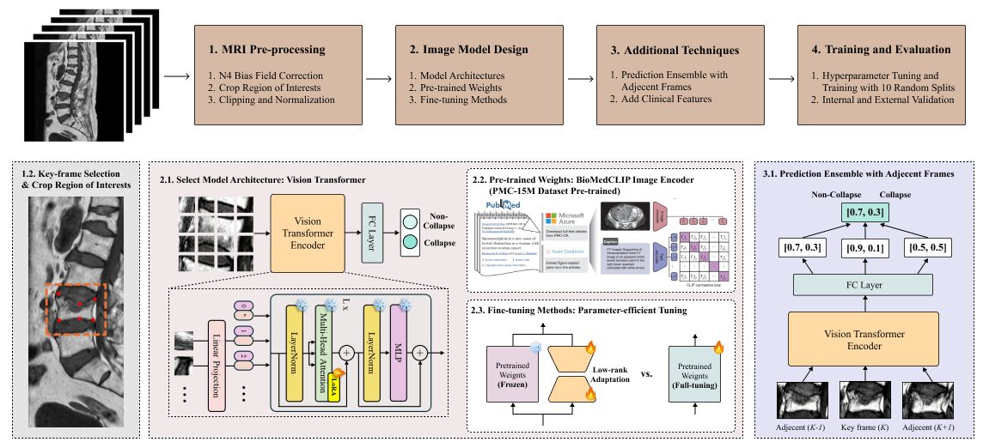
Workflow

Slide 10
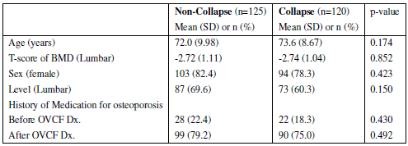
Demography
N? class balance?

Slide 11
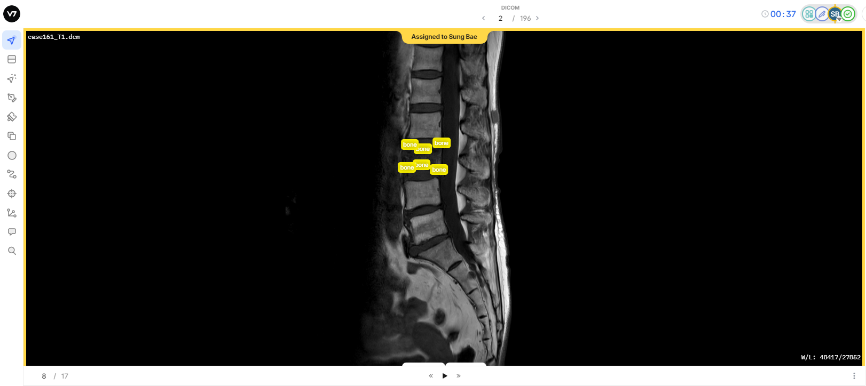
Preprocessing

Slide 12

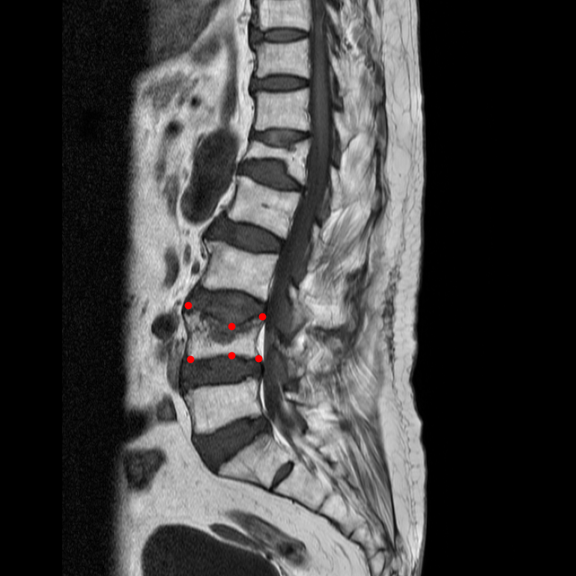
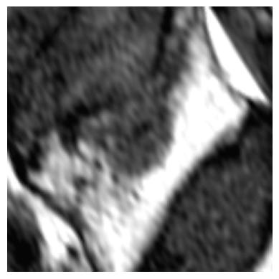
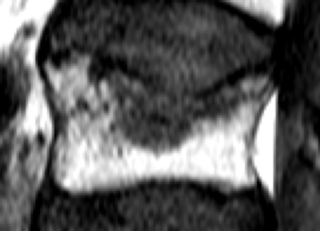
Preprocessing
Keypoint
Labeling
Data
Augmentation
150% Expanded ROI Crop
resolution? channel?

Slide 13
Model Design: Backbone & Pretrained Weights
 | Internal Validation |  |  | External Validation
 | AUC | Spec | Sens | AUC | Spec | Sens
CNN scratch | 0.7830 | 0.7844 | 0.6699 | 0.7097 | 0.6963 | 0.6611
CNN ImageNet | 0.7760 | 0.7910 | 0.6650 | 0.7772 | 0.6778 | 0.7889
ViT Scratch | 0.8149 | 0.8585 | 0.6595 | 0.7784 | 0.7519 | 0.6667
ViT ImageNet | 0.8185 | 0.8642 | 0.6517 | 0.7825 | 0.7333 | 0.7333

Slide 14
Model Design: Pretrained Weights
 | Internal Validation |  |  | External Validation
 | AUC | Spec | Sens | AUC | Spec | Sens
ViT Scratch | 0.8149 | 0.8585 | 0.6595 | 0.7784 | 0.7519 | 0.6667
ViT ImageNet | 0.8185 | 0.8642 | 0.6517 | 0.7825 | 0.7333 | 0.7333
ViT PMC | 0.8269 | 0.8057 | 0.7306 | 0.8051 | 0.7296 | 0.7556

Slide 15

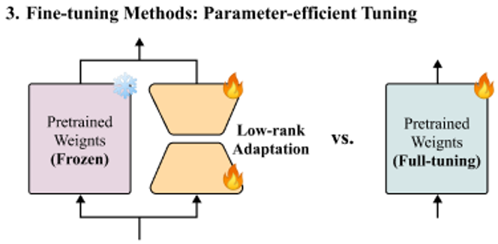

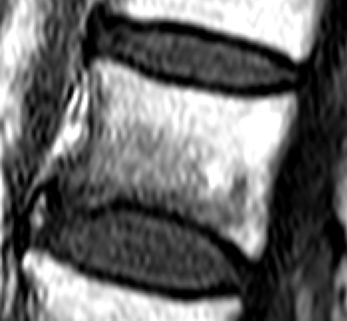


Model Design: Fine-tune Methods
+
MLP
Non-Collapse / Collapse
LayerNorm
Linear
L x
+
LoRA
Multi-Head Attention
Vision
Transformer
LayerNorm
0
*
1
2
$$⋯$$
Linear Projection
$$⋯$$

Slide 16
Model Design: Fine-tune Methods
 | # Trainable | Internal Validation |  |  | External Validation
 | Parameters | AUC | Spec | Sens | AUC | Spec | Sens
ViT PMC | 11 M | 0.8269 | 0.8057 | 0.7306 | 0.8051 | 0.7296 | 0.7556
ViT PMC LoRA | 0.89 M | 0.8404 | 0.8557 | 0.7012 | 0.8113 | 0.6963 | 0.8111

Slide 17
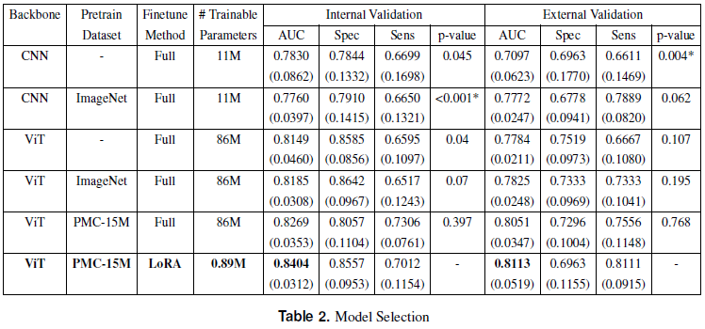
Model Selection

Slide 18
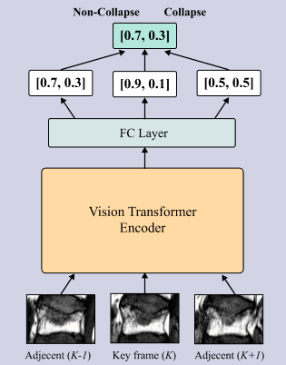
Additional Techniques: Data-level Ensemble
 | Internal Validation
 | AUC | Spec | Sens
ViT PMC LoRA | 0.8404 | 0.8557 | 0.7012
ViT PMC LoRA + Ensemble | 0.8539 | 0.8230 | 0.7739
 | External Validation
 | AUC | Spec | Sens
ViT PMC LoRA | 0.8113 | 0.6963 | 0.8111
ViT PMC LoRA + Ensemble | 0.8656 | 0.8111 | 0.7611

Slide 19
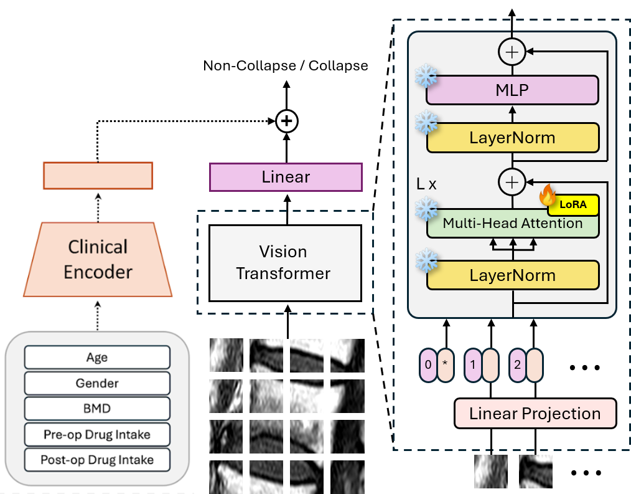
Additional Techniques: Clinical information
 | Internal Validation
 | AUC | Spec | Sens
ViT PMC LoRA | 0.8404 | 0.8557 | 0.7012
ViT PMC LoRA + Clinical | 0.8307 | 0.8016 | 0.7418
 | External Validation
 | AUC | Spec | Sens
ViT PMC LoRA | 0.8113 | 0.6963 | 0.8111
ViT PMC LoRA + Clinical | 0.8103 | 0.6741 | 0.8611

Slide 20
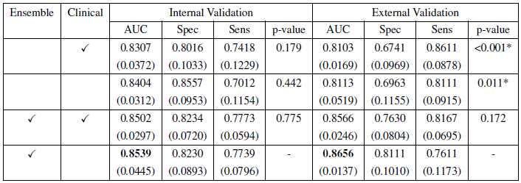
Additional Techniques

Slide 21
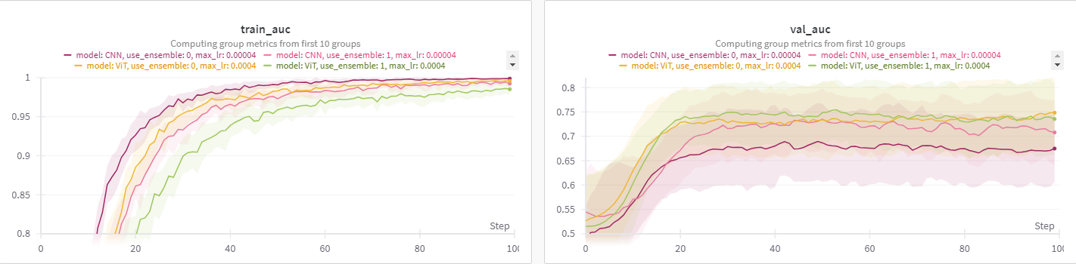
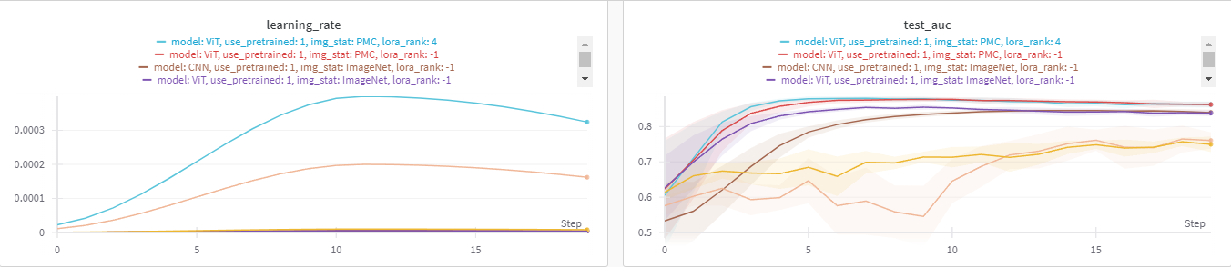
Hyperparameter Tuning

Slide 22
Hyperparameter Tuning
(1) Short epoch + Broad range fixed learning rate
Objective: Identify “possible” range (underfitting X, overfitting X)
(2) Longer epoch + Narrow range fixed learning rate + Other h.p. tune
e.g. weight decay, batch size, lora_rank
Objective: Stabilize training… Find good candidates!
(3) Scheduler selection + Scheduler h.p. tune (e.g. warmup)
Objective: Find best setting!
(4) Excessive epoch + early stop + seed
Objective: Find best score!

Slide 23
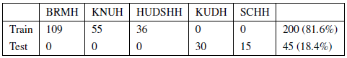
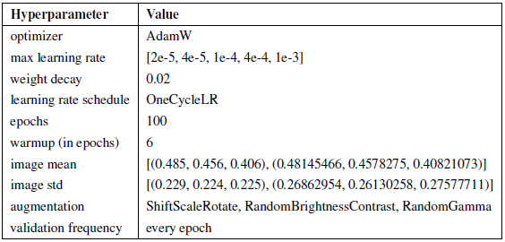
Setup

Slide 24
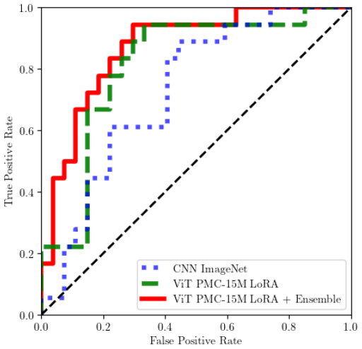
ROC Curve

Slide 25
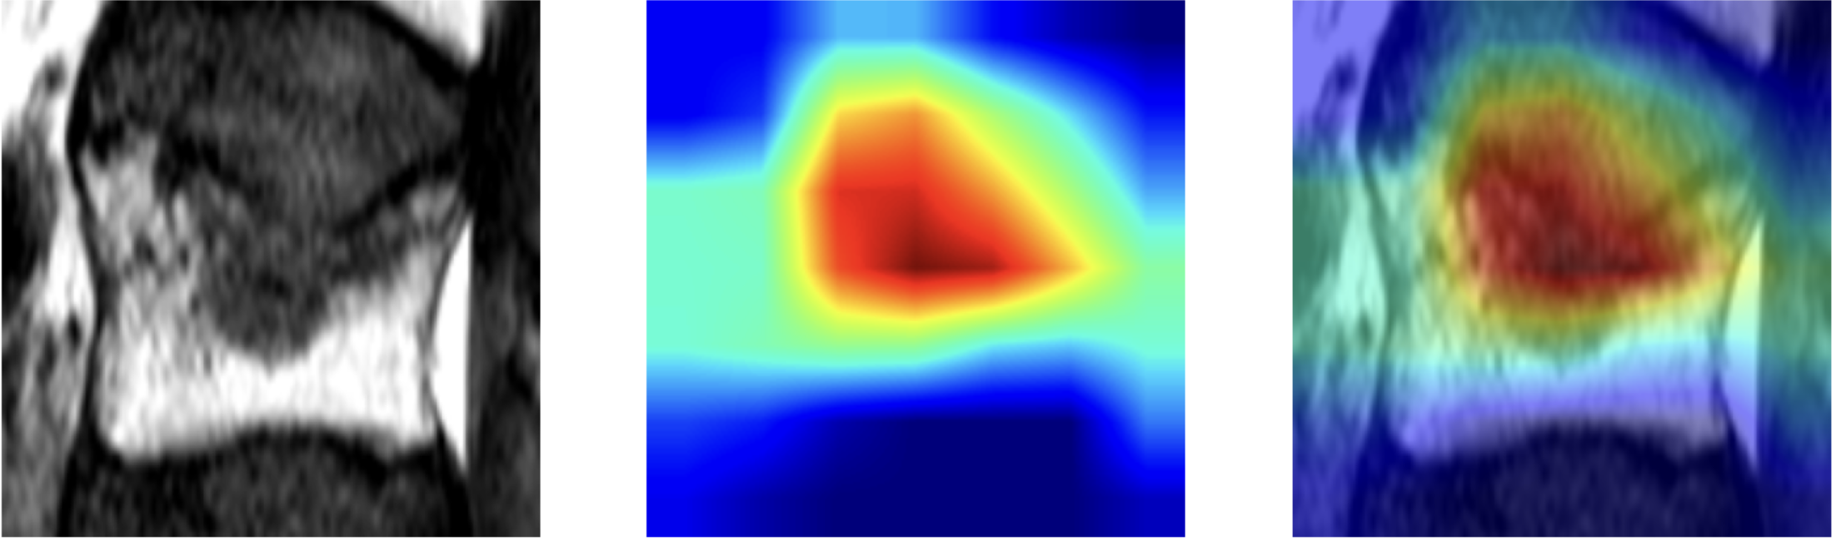
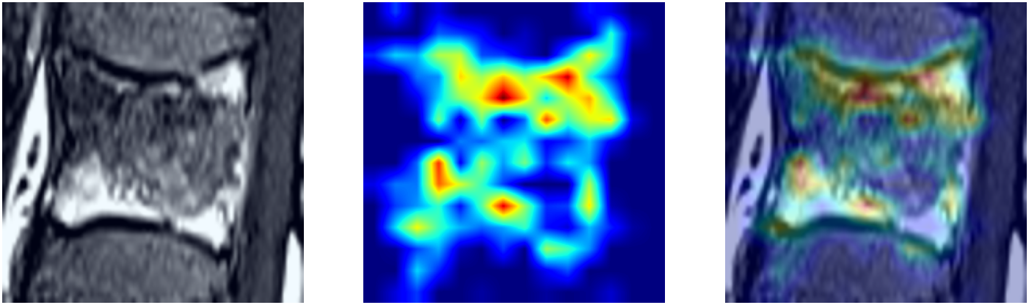
Grad-CAM: True Positive Example
CNN
ViT

Slide 26
Key Results

Slide 27
Reference
Yabu, A. et al. Using artificial intelligence to diagnose fresh osteoporotic vertebral fractures on magnetic resonance images. Spine J 21, 1652-1658, doi:10.1016/j.spinee.2021.03.006 (2021).
Tomita, N., Cheung, Y. Y. & Hassanpour, S. Deep neural networks for automatic detection of osteoporotic vertebral fractures on CT scans. Comput Biol Med 98, 8-15, doi:10.1016/j.compbiomed.2018.05.011 (2018).
Ashish Vaswani, Noam Shazeer, Niki Parmar, Jakob Uszkoreit, Llion Jones, Aidan N Gomez, Lukasz Kaiser, and Illia Polosukhin. Attention is all you need. NeurIPS, 2017.
Dosovitskiy, A. et al. An image is worth 16x16 words: transformers for image recognition at scale. In International Conference on Learning Representations (ICLR, 2021).
Zhang, Y., Jiang, H., Miura, Y., Manning, C. D. & Langlotz, C. P. Contrastive learning of medical visual representations from paired images and text. In Machine Learning for Healthcare Conference (eds Lipton, Z. et al.) 2–25 (PMLR, 2022).
Alec Radford, Jong Wook Kim, Chris Hallacy, Aditya Ramesh, Gabriel Goh, Sandhini Agarwal, Girish Sastry, Amanda Askell, Pamela Mishkin, Jack Clark, Gretchen Krueger, and Ilya Sutskever. 2021. Learning transferable visual models from natural language supervision. In International Conference on Machine Learning.
E. J. Hu, Y. Shen, P. Wallis, Z. Allen-Zhu, Y. Li, S. Wang, L. Wang, and W. Chen. Lora: Low-rank adaptation of large language models. arXiv preprint arXiv:2106.09685, 2021.

